Slide 1
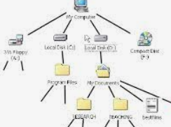


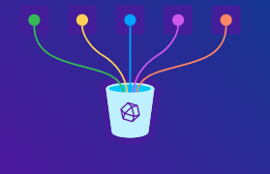

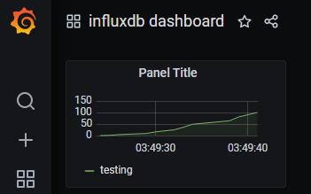
Data flow with Time Series DB
curl http://borg:8086/data.cgi
-F data=@data.txt
$influx->write(
$point, database => $data);
http://influx:8086/write?db=data
-d ‘swap,host=host 0.85 1656472338’
influxdb Source
http://influx:8086

Slide 2

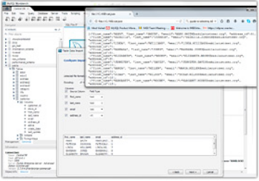
Data flow with classic DB
curl http://borg:8086/data.cgi
-F data=@data.txt
$DBI->prepare($query);
$DBI->execute
influxdb Source
http://influx:8086

Slide 3


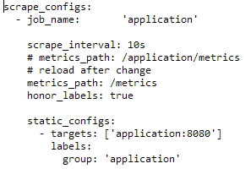

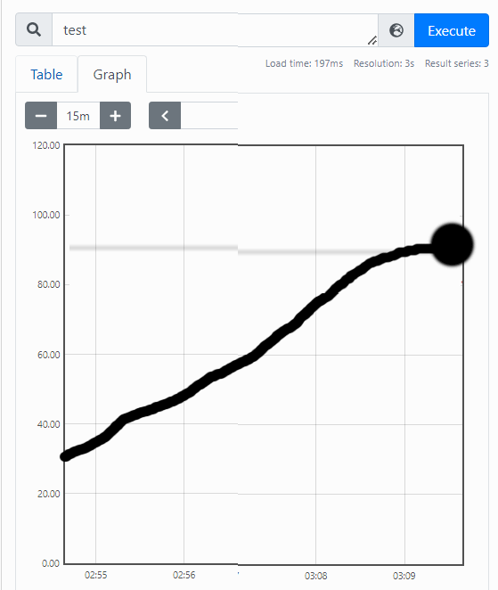
Ephemeral Data Point flow with Prometheus
https:8443//pwp/prometheus/metrics
prometheus Source
http://prometheus:9090

Slide 4
Data Backfill into InfluxDB or Regular DB
connection.prepareStatement(
"insert into data values (?,?,?)").addBatch()
influxDB.write(
BatchPoints.builder().points().build());
prometheus Source
http://prometheus:9090

Slide 5

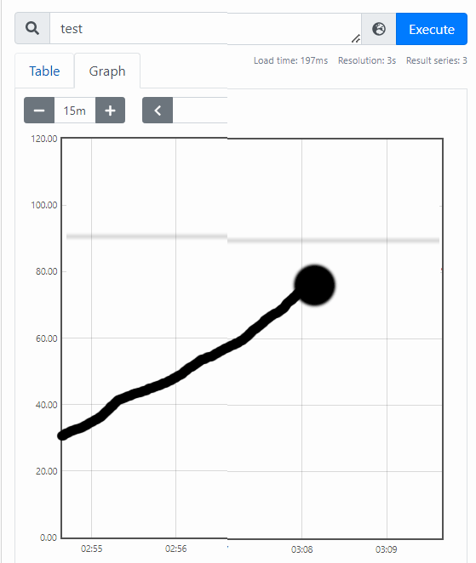
Data flow with Influx DB and Prometheus
(exotic scenario – not to be used)
curl http://borg:8086/data.cgi
-F data=@data.txt
$influx->write(
$point,
database => $data
);
http://influx:8086/write?db=data
-d ‘swap,host=host 0.85 1656472338’
influxdb_exporter
prometheus Source
http://prometheus:9090

Slide 6
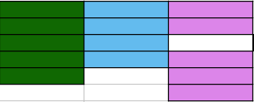
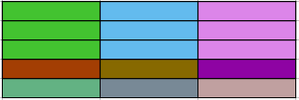
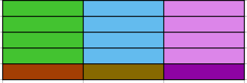
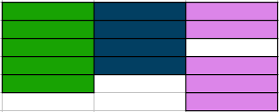
Historic Data Ingestion Scenarios
Timeseries backfill style
Snapshot scraping style

Slide 7
InfluxDB 1.x vs. 2.x
SQL Query style
NoSQL Style
db = InfluxDBFactory.connect host user, pass
point = Point.measurement seriesName
.time System.currentTimeMillis()
.tag "hostname", hostname
.addField "idle", 40L
.build()
db.writePoint point
BatchPoints.builder().points(points).build
db.write batchpoints
db.write "cpu,hostname=host value=60.0"
client = InfluxDBClientFactory.create host, token, org
api = client.getWriteApiBlocking
api.writePoint
Point.measurement "cpu"
.addTag "hostname", "hostname"
.addField "value", 55D
.time Instant.now()
api.writeRecord
"cpu,hostname=host value=60.0"
api.writeMeasurement new POJO
influxDB = InfluxDBFactory.connect
query = new Query queryString, databaseName
response = influxDB.query "select * from testing"
results = response.getResults
while results.iterator.hasNext
client = InfluxDBClientFactory.create host, token, org
api = client.getInfluxQLQueryApi
tables = queryApi.query
from(bucket:testbucket)
|> range(start: 0)
|> filter(fn: (r) => r["_measurement"] == "cpu")
records = table.getRecords
record.getValueByKey

